Slide 1
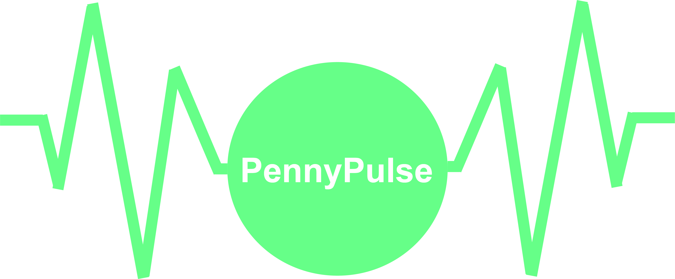

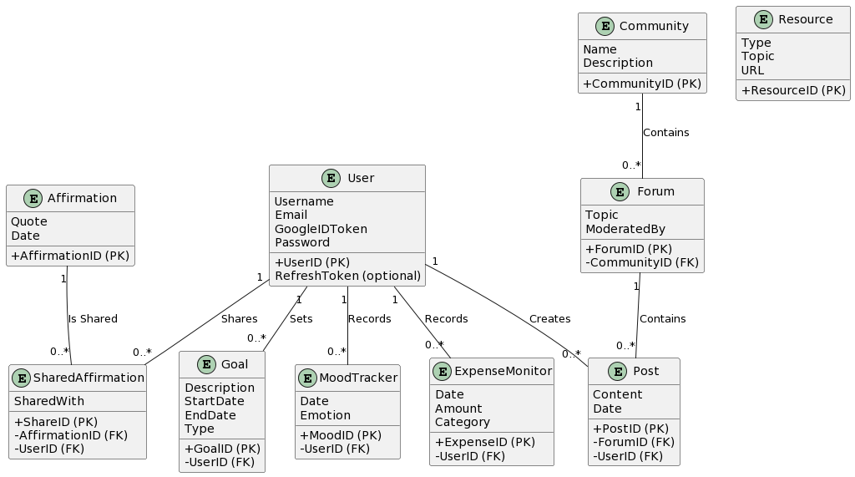

PennyPulse
The app where you can empower your life!
CSA 499 2023
BACKGROUND
team MEMBERS
In today’s world, people are met with challenges that make it difficult to maintain a balanced life. These challenges can range from personal, and professional responsibilities and stress on one’s mental, emotional and financial well being. This is where PennyPulse emerges a guiding light. PennyPulse provides an integrative experience that helps users monitor their mental health, manage their emotions, and maintain financial stability. With PennyPulse, users have access to an app where they can empower the quality of their life.
Shrijan Pant, Shreyas Srinivasa, Hrishikesh Vikram, Warren Spencer, Sean-Morgan Neville, Matthew Garron.
Bridge model
Bridge to PennyPulse App Goal: Complete the development process for the PennyPulse app.
Horizontal Development Process
Vertical Development Process
PennyPulse App Logo
RESEARCH GOALS
Find a way to help individuals maintain equilibrium with the multitude of challenges of daily life.
Create a platform that provides insights into various aspects of an individual's life, and also empowers them with resources and tools to foster positive change and make informed decisions.
Develop an application that provides users with a rich interface that provides an integrative experience that is advanced and easy to navigate.
Back-end
Development
Database Connection
Front-end Development
Testing
Deployment
UI Design
UI Design - Creating wireframes and initial design concepts using Adobe XD
Project Objectives
Front-end development – Implement the UI and create necessary APIs or services
Implement daily mood tracking that monitors a user's mood to improve one’s mental health.
Implement expense monitoring to help users make informed financial decisions.
Allow users to set goals and objectives with goal setting.
Offer a source of motivation with motivational affirmations to give users a sense of ambition.
Implement a resource hub to give users access to information and resources.
Provide community interaction where users can interact and engage with each other for shared experiences.
Back-end Development - Write the foundational backend logic and ensure all functionalities are covered
Database Connection - Set up database schemas, tables, and relationships and ensure data flows correctly and securely
TECHNICAL APPROACH
Here is the technical approach to implement PennyPulse’s features and functionality:
Programming Languages and Frameworks: Swift, Plaid, Firebase, HTML, CSS, Flask
Modern, intuitive UI/UX using Swift’s widget library
Storing real-time data like mood entries and expenses with Firebase Firestore Database
Options for email/password, Google Sign-In, and Facebook using Sign-InFirebase Authentication
Real-time chat enabled by Firebase Realtime Database
Admin dashboard for managing articles, videos, and podcast content in the Resource Hub
Cloud Firestore for storing structured data like articles, user profiles, and community posts
Testing - Conduct rigorous testing such as unit tests, integration tests, and user acceptance testing
Deployment - Deploy the application to the target environment/server and perform final tests in the production environment to ensure everything is running smoothly
PROJECT GOALS
Here are the project’s goals:
Create a mobile application that helps individuals maintain a balanced and more positive life and gives them a sense of empowerment
Implement a rich and intuitive UI/UX design and interface
Allow users to engage with each other and share useful information and resources
Provide modern and innovative state-of-the-art technology that aims to help users make better decisions to improve their daily life
Coming Soon!
Notes:
1
1
1
1

